Slide 1
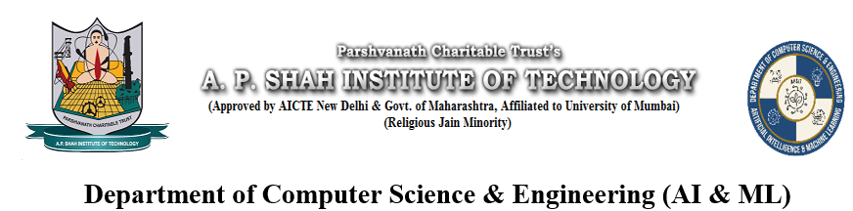
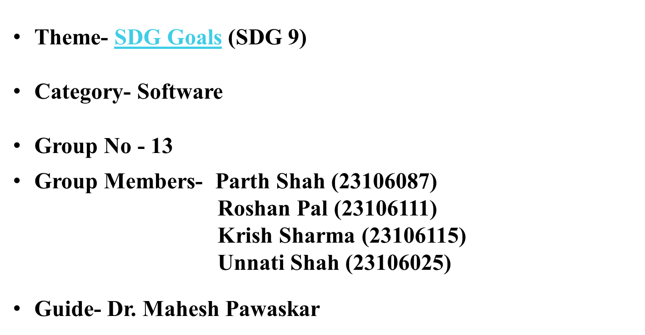
Deepfake content Detection

Slide 2
Introduction
Deepfake videos made using AI are now very realistic and easy to create.
They can make people appear to say or do things they never did.
These fake videos spread quickly on social media and messaging apps.
They are used to spread misinformation, damage reputations, and create fake announcements.
Colleges and institutions do not have an affordable system to verify if a video is real or fake.
This reduces trust in digital and official communication.

Slide 3
Literature Survey of the existing system
Conference / Journal | Key Points | Improvements Proposed
IEEE Access (2025) | Evaluated CNN-LSTM frameworks for temporal analysis of video fakes. | Integration of Vision Transformers (ViT) to capture long-range global facial dependencies.
Journal of AI Research (2025) | Identified the "Generalization Gap" where models fail on cross-dataset testing. | Implementation of Multi-modal fusion to correlate audio spectrograms with visual facial movements.
arXiv Preprint (2025) | Analyzed the impact of social media compression on detection accuracy for "In-the-Wild" videos. | Development of Continuous Learning pipelines to adapt models to weekly generative AI updates.
IEEE/CVF CVPR (2024) | Benchmarked ResNet and EfficientNet against high-fidelity Diffusion-based deepfakes. | Adoption of Frequency Domain analysis (DCT) to identify spectral anomalies missed by pixel analysis.

Slide 4
Limitations of existing Systems
Models do not perform well on real-world videos.
Most systems check only faces, not body or audio issues.
They need high-end GPUs, which small colleges may lack.
Many tools cannot detect videos in real time.
Results show only “Real” or “Fake” with no confidence score.

Slide 5
Problem statement
Deepfake AI can create very realistic fake videos.
These videos can spread false information and harm people’s reputation.
Colleges do not have easy and affordable tools to check video authenticity.
There is a need for a scalable AI system to detect deepfake videos accurately.

Slide 6
Proposed System
Input: User uploads video for AI content analysis
Processing:
Content sent to detection models (video analysis)
Models predict AI-generation probability scores
Output: Displays confidence percentages

Slide 7
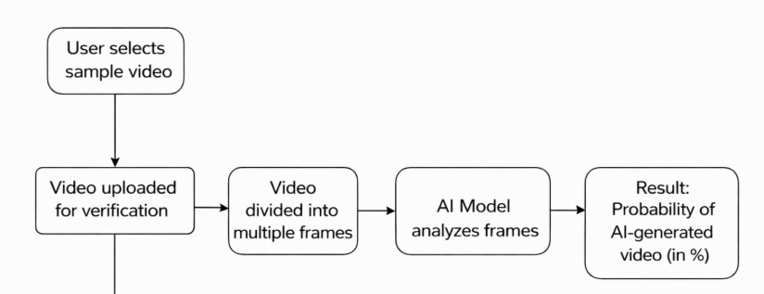

Proposed System

Slide 8
Experimental Setup
Input / Dataset
Real and deepfake video datasets such as FaceForensics++ and DeepFake Detection Challenge (DFDC).
Performance Evaluation Parameters
F1-Score
AUC-ROC
Software Setup
Python
TensorFlow / PyTorch
OpenCV, NumPy
Jupyter Notebook / VS Code

Slide 9
Technologies and Methodologies
Technologies Used :
Frontend: React, HTML,Javascript,CSS
Backend: Node.js, Express
AI/ML: CNN (EfficientNet) + CLIP embeddings
Inference: PyTorch / TensorFlow Serving

Slide 10
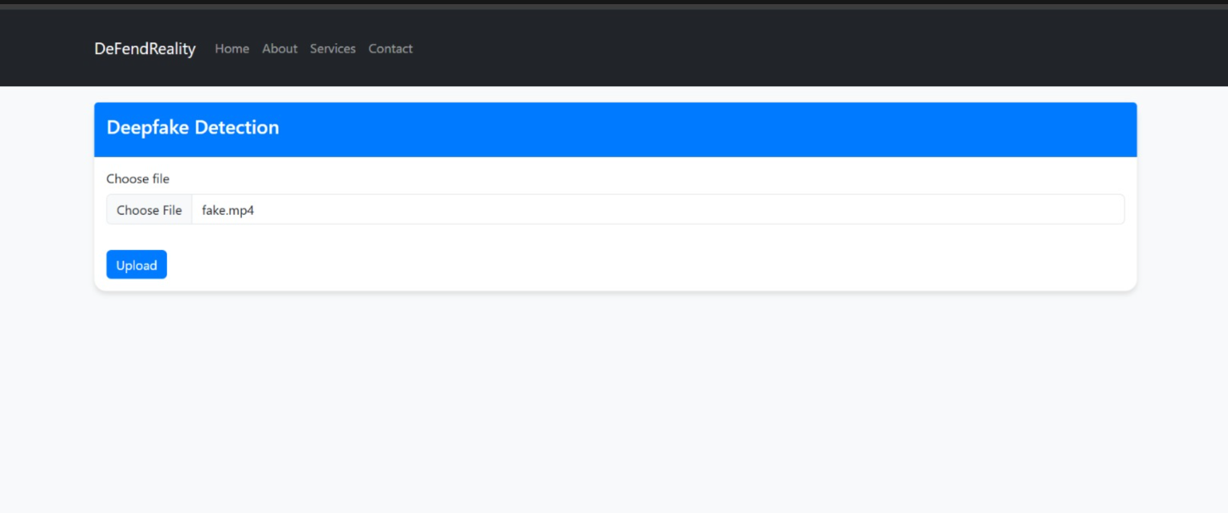
Input page:
Implementation

Slide 11
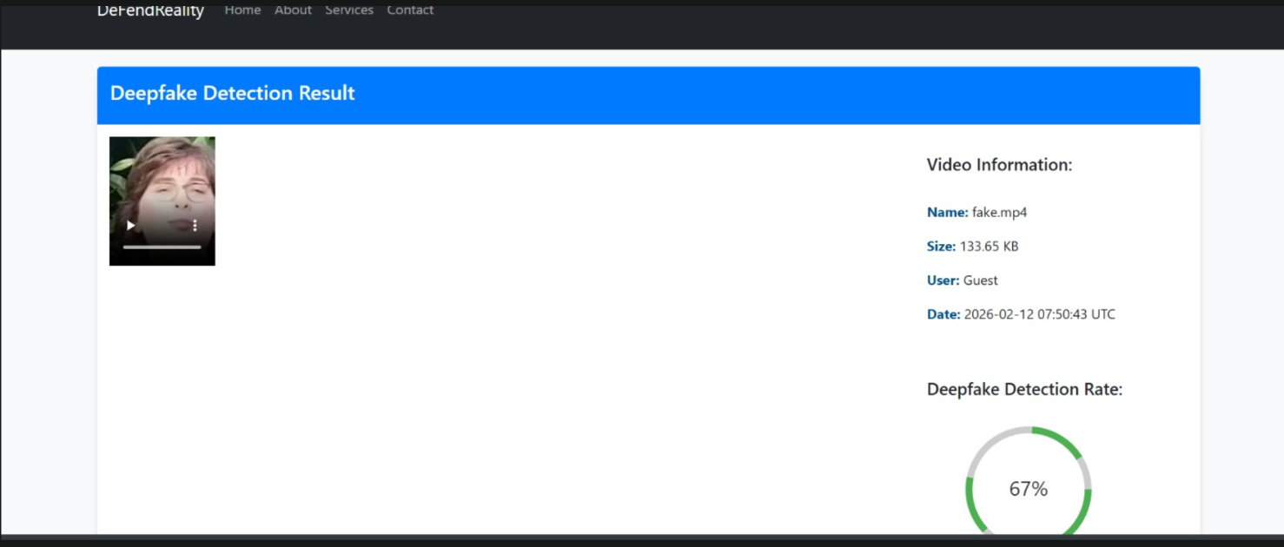
Output :
Implementation

Slide 12
Conclusion
Developed an AI-powered deepfake video detection system using models like ResNet and EfficientNet to identify subtle manipulation artifacts.
Designed a transparent, low-cost, and scalable platform for students and institutions.
Future work
Integrate temporal models (RNN/LSTM) and audio analysis for multi-modal detection.
Improve explainability (e.g., Grad-CAM) and robustness against adversarial attacks.
Deploy as a browser extension and scale using cloud infrastructure (AWS/GCP).

Slide 13
References
[1] Khan, I., Khan, K., and Ahmad, A., "A Comprehensive Survey of DeepFake Generation and Detection Techniques in Audio-Visual Media", ICCK Journal of Image Analysis and Processing, vol. 1, no. 2, pp. 73–95, 2025.
[2] Abbas, F., and Taeihagh, A., "Unmasking Deepfakes: A Systematic Review of Deepfake Detection and Generation Techniques Using Artificial Intelligence", Expert Systems with Applications, 2024, Article 124260.
[3] Sunil, R., Mer, P., Diwan, A., Mahadeva, R., and Sharma, A., "Exploring Autonomous Methods for Deepfake Detection: A Detailed Survey on Techniques and Evaluation", Heliyon, vol. 11, no. 3, 2025.
[4] Croitoru, F.-A., Hiji, A.-I., Hondru, V., et al., "Deepfake Media Generation and Detection in the Generative AI Era: A Survey and Outlook", arXiv preprint arXiv:2411.19537, 2024.
[5] Liu, P., Tao, Q., and Zhou, J. T., "Evolving from Single-modal to Multi-modal Facial Deepfake Detection: A Survey", arXiv preprint arXiv:2406.06965, 2024.
[6] Li, M., Ahmadiadli, Y., and Zhang, X.-P., "Audio Anti-Spoofing Detection: A Survey", arXiv preprint arXiv:2404.13914, 2024.

Slide 14
Thank You...!!

